Slide 1


Slide 2



Updates in the treatment of hypertension; Renal Denervation
M. H. Shojamoradi, Nephrologist
Imam Khomeini Hospital Complex,
Tehran University of Medical Sciencee
May, 2023

Slide 3
Outlines
Physiology of Renal Nerves
Pathophysiology of RDN in BP improvement
Clinical implications of RDN
Novel therapies for hypertension management

Slide 4
Physiology of Renal Nerves

Slide 5
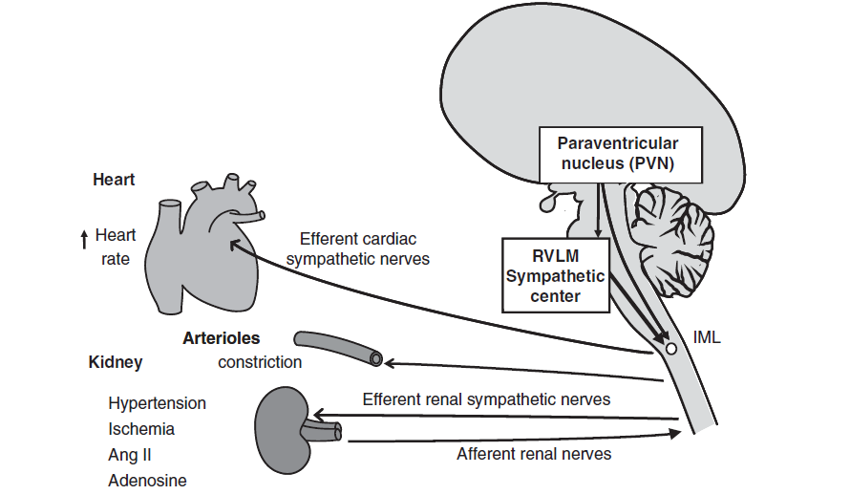
sensory afferents densely innervated in the renal pelvis and also in renal cortex .
activation of renal afferent nerves (baroreceptor, chemoreceptor) increases sympathetic nerve activity by stimulating pre-sympathetic neurons in brain.

Slide 6
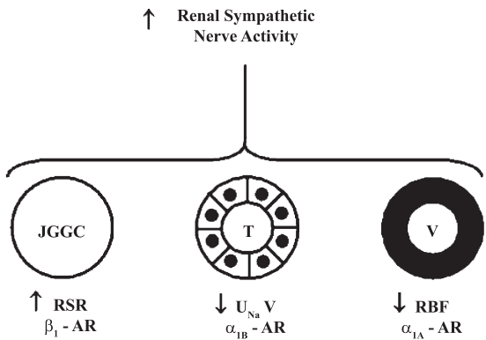
Fluid regulation by renal nerves
Activation of the efferent renal sympathetic nerves:
  renin secretion
  sodium reabsorption
  increased renal vascular resistance

Slide 7
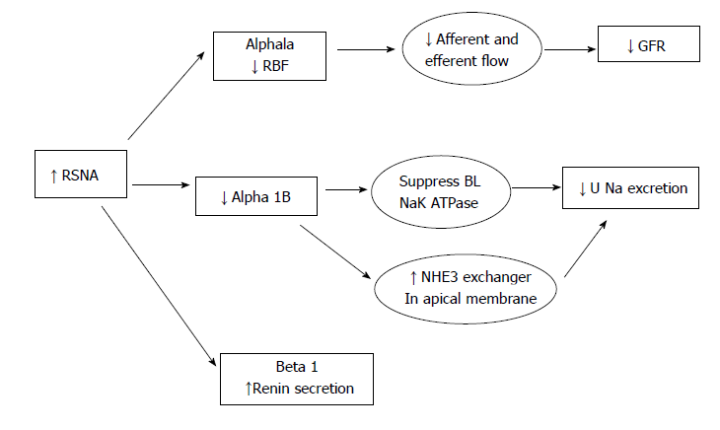
Interaction of renal nerves and tubules
Extensive sympathetic innervation in entire tubule
Most dense in TAL
Activation of the SNS:
  Increased NHE3
  Increased NA-K ATPase
  Activation of NKCC2
  ENaC expression
Increased AQP2

Slide 8
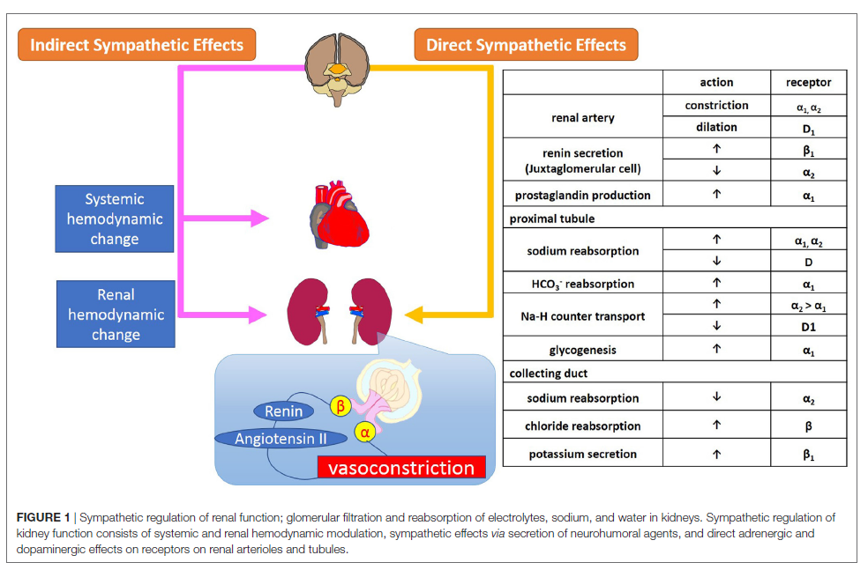

Slide 9
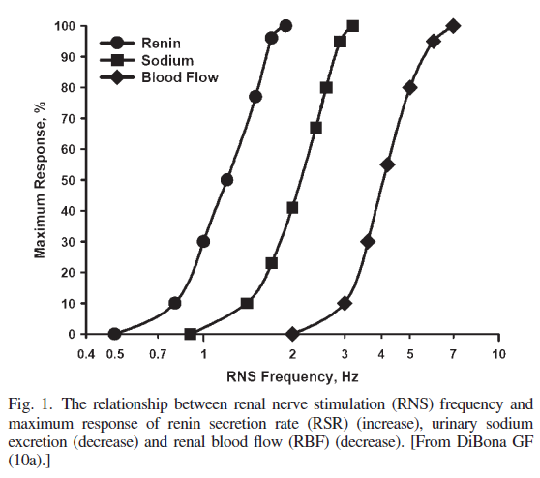

Slide 10
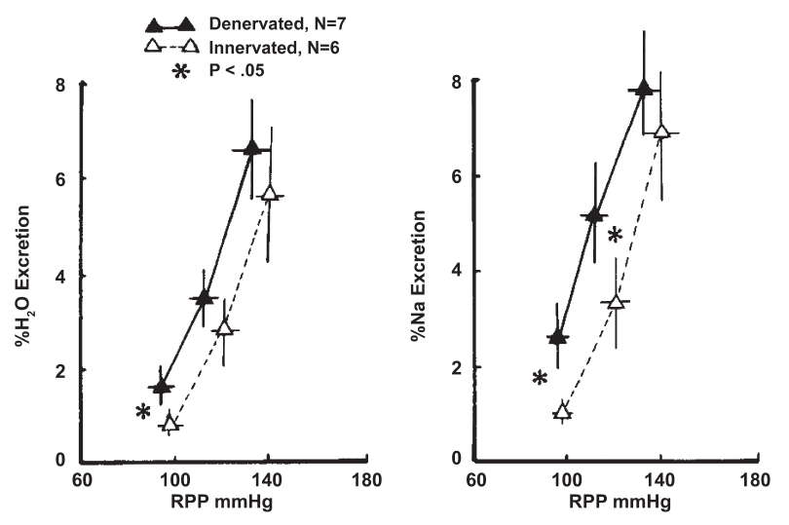

Slide 11
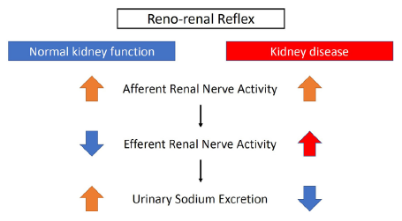
Renorenal Reflex
Pelvic pressure or high salt intake:
  activates ARSN
  inhibits ERSNA
Reversal of reno-renal reflex
  ischemic kidneys
  chronic hypertension

Slide 12
Pathophysiology of RDN in BP improvement

Slide 13
Mechanisms of RDN-Induced BP Lowering
Renal afferent signaling
Renal efferent neural signaling
  Suppression of RAAS
  Increased renal sodium and water excretion

Slide 14
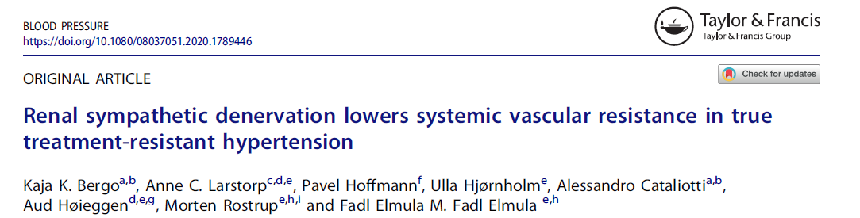
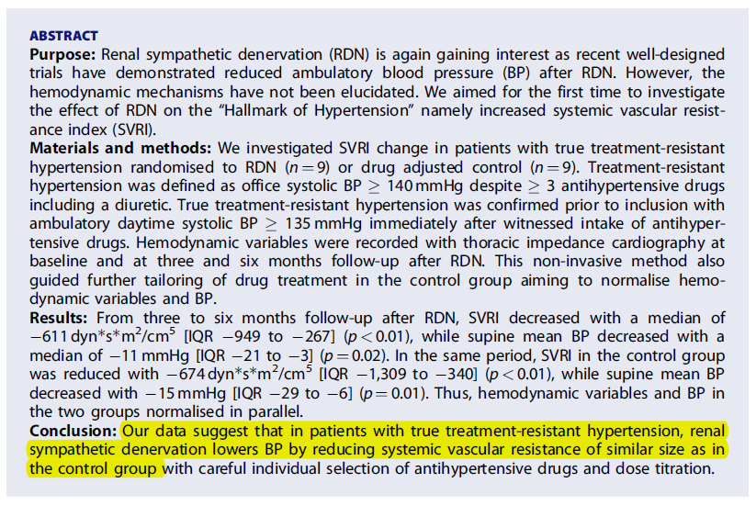

Slide 15
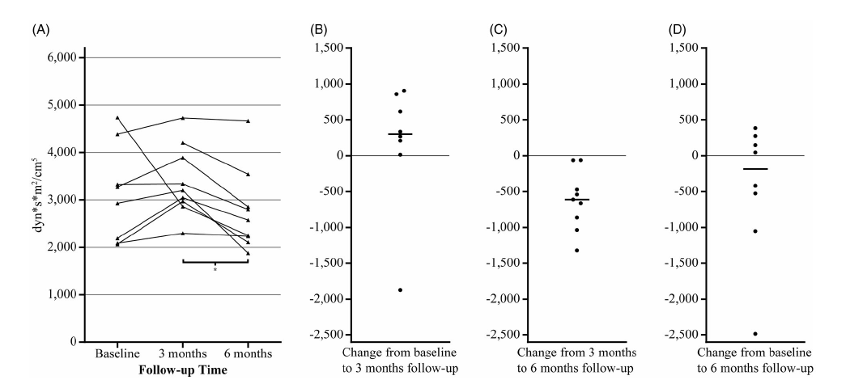
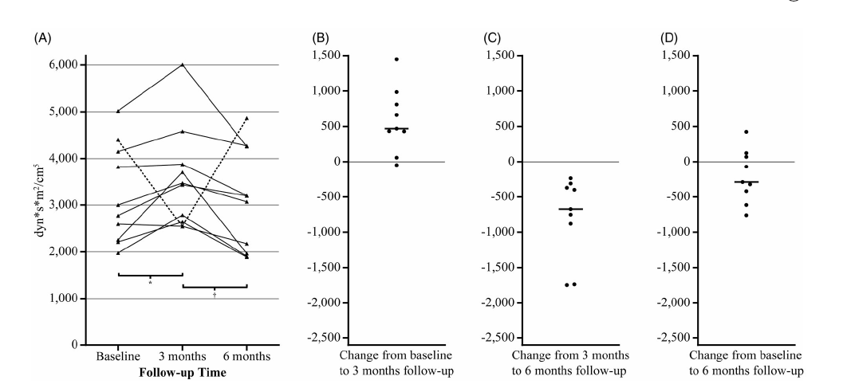
RDN group
Control group

Slide 16
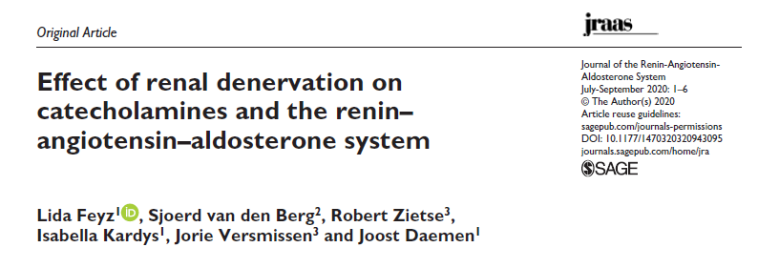
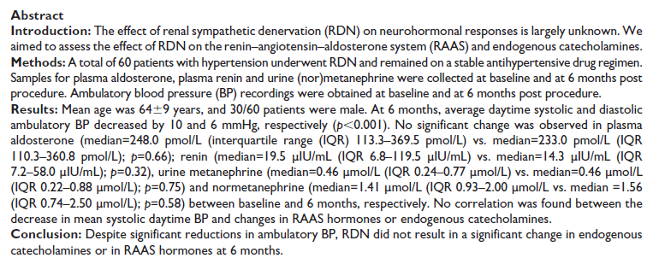

Slide 17
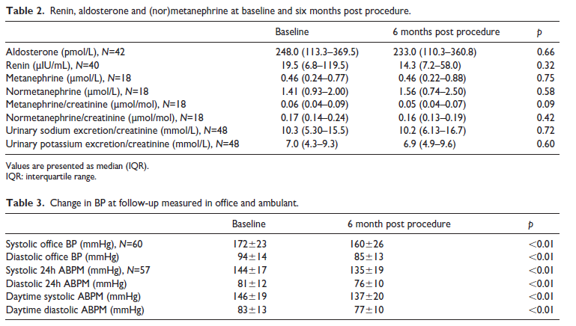

Slide 18
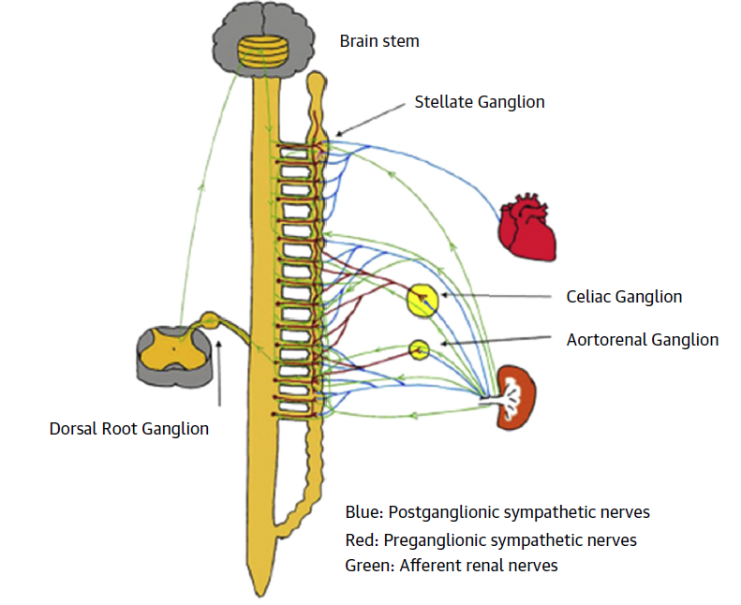
Persistant effect of RDN
renal denervation
  brain stem and stellate ganglion remodeling
  reduce nerve activity.
    inhibition of afferent nerve signaling
    retrograde trans-synaptic degeneration
Potential role of inflammatory pathways

Slide 19
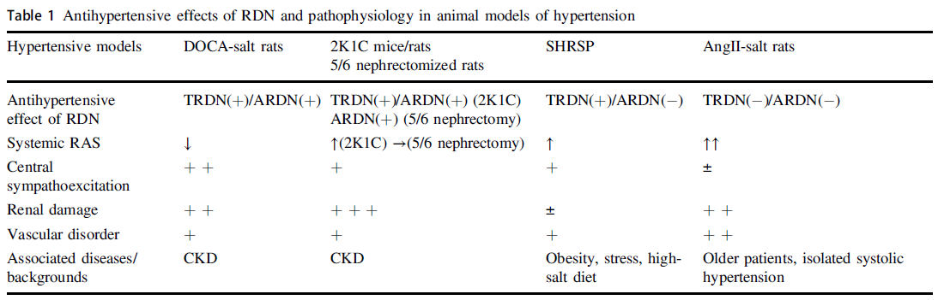
Total versus Afferent RDN

Slide 20
Methods to Assess the Efficacy of RDN
Direct neural stimulation of afferent renal nerves
  Pressor vs depressor nerves
Indirect testing via reflex responses
  Mental stress, head-up tilt, isometric hand grip, lower body negative pressure
Passive monitoring
  NE spillover, renal sympathetic traffic

Slide 21
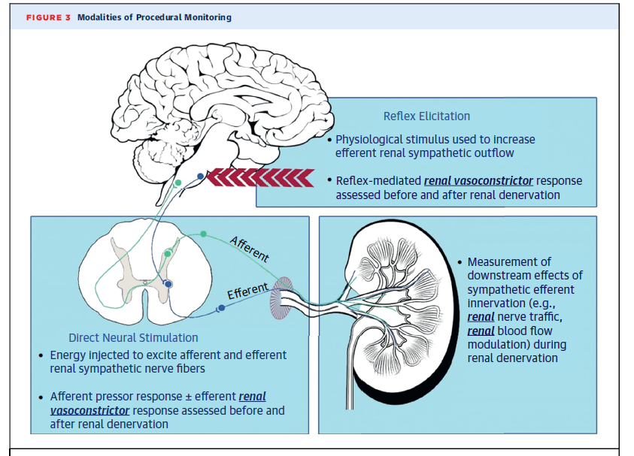

Slide 22
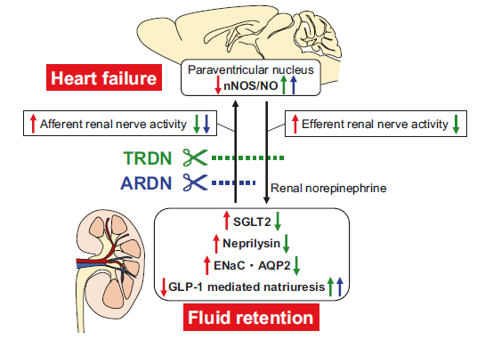
renal nerve activity and fluid retention in heart failure

Slide 23
Clinical implications of RDN

Slide 24
Symplicity HTN-3 trial
No BP-lowering efficacy of mono-electrode RF catheter compared with sham procedure at 6 months
methodological limitations of trial:
  frequent medication change
  limited experience of the proceduralists,
  incomplete circumferential ablation
  new insights on renal nerve distribution

Slide 25
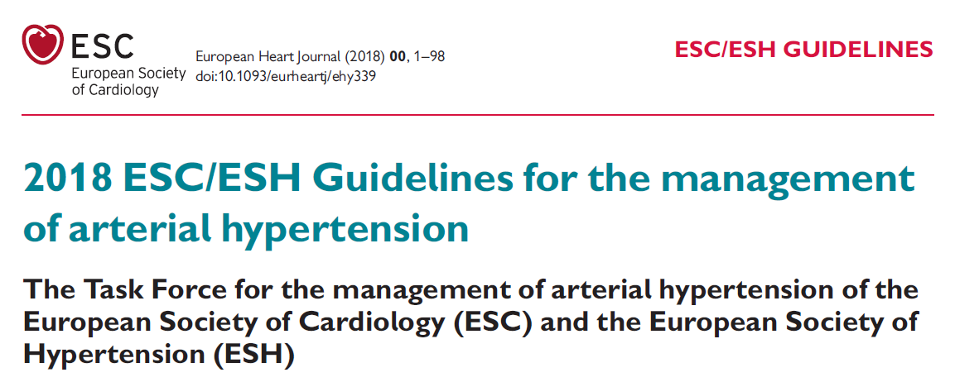
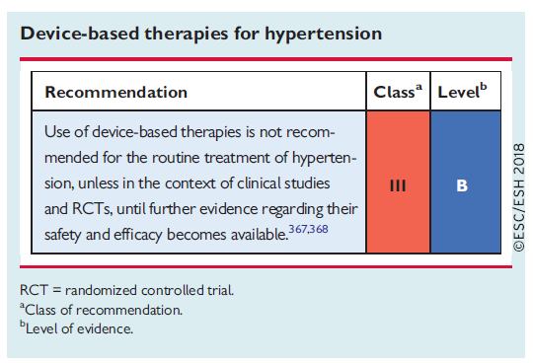

Slide 26
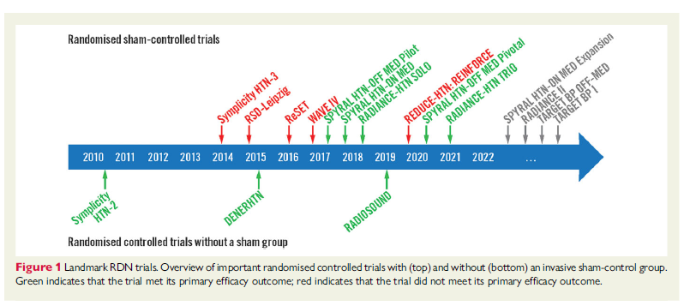

Slide 27
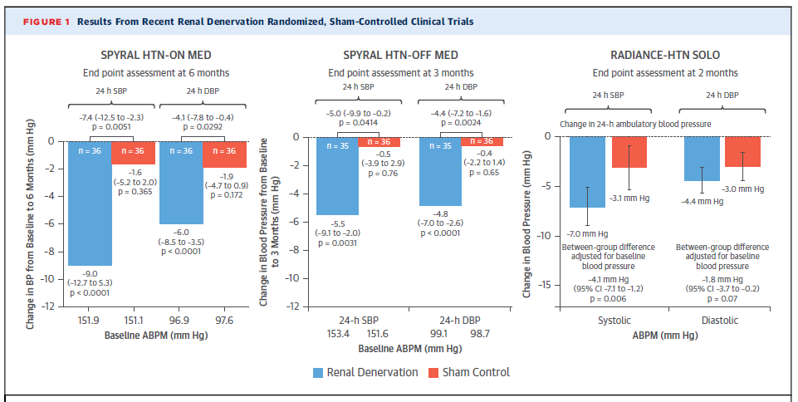

Slide 28
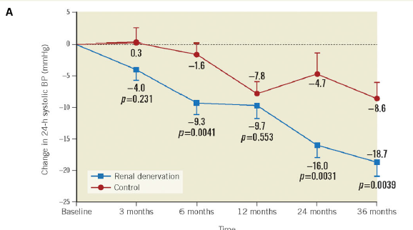
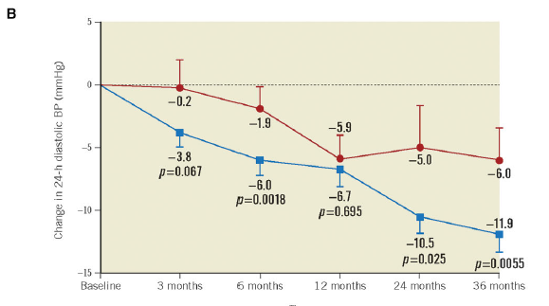

Slide 29
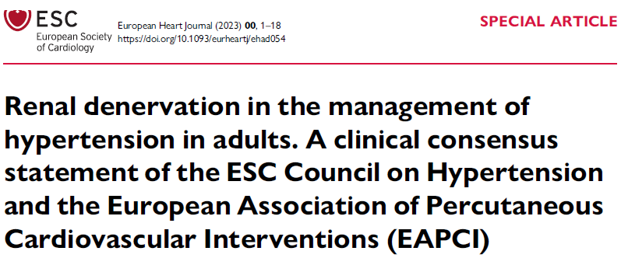

Slide 30
Patient selection
RDN in resistant hypertension
Hypertension-mediated organ damage and CV risk
Patient preference

Slide 31
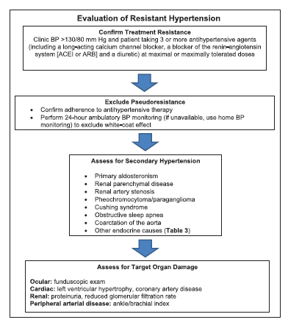
Patient selection
RDN in adult patients with uncontrolled resistant hypertension and an eGFR ≥40
High CV risk favours the use of RDN
possible treatment for patients not tolerate antihypertensive drugs in long term
patients who express preference to undergo RDN

Slide 32
RDN not advised in:
Kidney transplant recipients
CKD G4 and G5
Fibromuscular dysplasia
Untreated secondary hypertension
Single functioning kidney
Haemodialysis.

Slide 33
Durability
Questions regarding functional re-innervation of kidneys following RDN

Slide 34
Drug interaction
Possible drug interaction of RDN with central sympatholytics:
  Clonidine
  Spironolactone
  Patients with greater sympathetic dependence (clonidine-sensitive) may represent a more susceptible population for RDN.

Slide 35
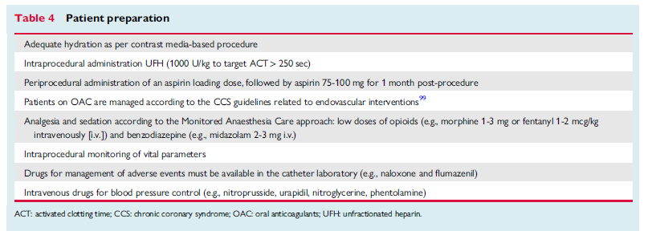
Patient preparation

Slide 36
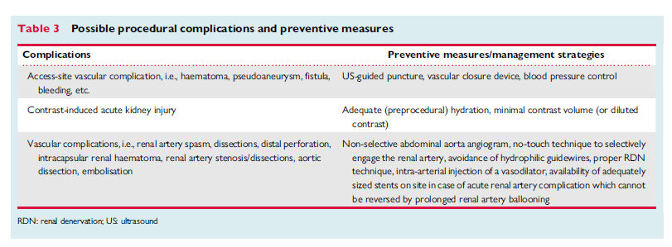
Acute complications

Slide 37

long-term Concerns
de novo renal artery stenosis secondary to vascular injury induced by RDN
  pooled annual incidence rate for renal artery stenting was 0.2%, similar to other patients with HTN
worsening kidney function
  no significant change in eGFR after follow-up of 9.1 months

Slide 38
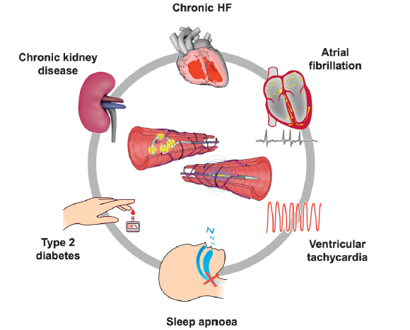
Indications other than hypertension

Slide 39
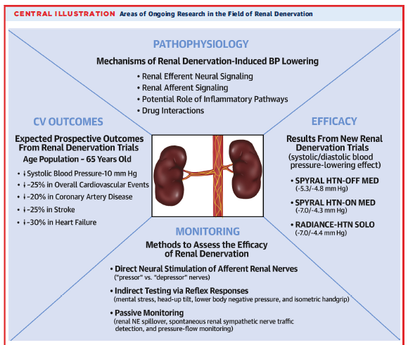

Slide 40
Novel therapies for hypertension management

Slide 42
Therapeutic Classes Under Development
Non-steroidal mineralocorticoid receptor blockers (ns-MRA)
Aldosterone synthetase inhibitors
Aminopeptidase A inhibitors
Dual endothelin antagonists
Atrial natriuretic peptide analogs

Slide 43
ns-MRA
higher selectivity for the MR
less hyperkalemia
stimulate various genomic reactions, better overall efficacy and safety profile
Drugs
  Finerenone
    spironolactone and eplerenone, primarily accumulate in kidneys
    finerenone is distributed evenly between the heart and the kidneys
  Esaxerenone
  Ocedurenone

Slide 44
Aldosterone synthetase inhibitors
Primary aldosteronism:
  adrenalectomy or aldosterone-blocking agents
Fadrozole
  fungicide
  aromatase inhibitor
  inhibition both AS and 11-hydroxylase (CYP11B1)
nine ASIs
  baxdrostat

Slide 45
Aminopeptidase A inhibitors
APA converts AII to AIII in brain
Angiotensin III affects blood pressure by increasing central concentrations of vasopressin
APA inhibitor, EC33, decrease blood pressure by reducing angiotensin III in brain without affecting systemic levels
Firibastat is a novel prodrug that is metabolized to EC33

Slide 46
Dual endothelin antagonists
Endothelin-1
  Vasoconstriction, endothelial dysfunction, aldosterone synthesis, increases catecholamine release
Two types of endothelin (ET) receptors: ETA and ETB
Both are found on smooth muscle cells, mediate vasoconstriction
Only ETB receptors are present on endothelial cells and mediate vasodilation
Unopposed ETA blockade
  over-stimulation of ETB receptors
  non-selective vasodilation
  increased vascular permeability
  increased peripheral edema
  increased plasma vasopressin and aldosterone levels.
Aprocitentan is a non-selective ERA but has a 16-fold higher affinity for the ETB receptor

Slide 47
Atrial natriuretic peptide analogs
M-atrial natriuretic peptide
  40 amino acid designer natriuretic peptide
  activates the GC-A receptor
  Increase cGMP
  Mediates
    Natriuresis
    vasodilatation
    aldosterone inhibition
  Resistance to enzymatic degradation

Slide 49
Thanks a lot for your attention

